Slide 1

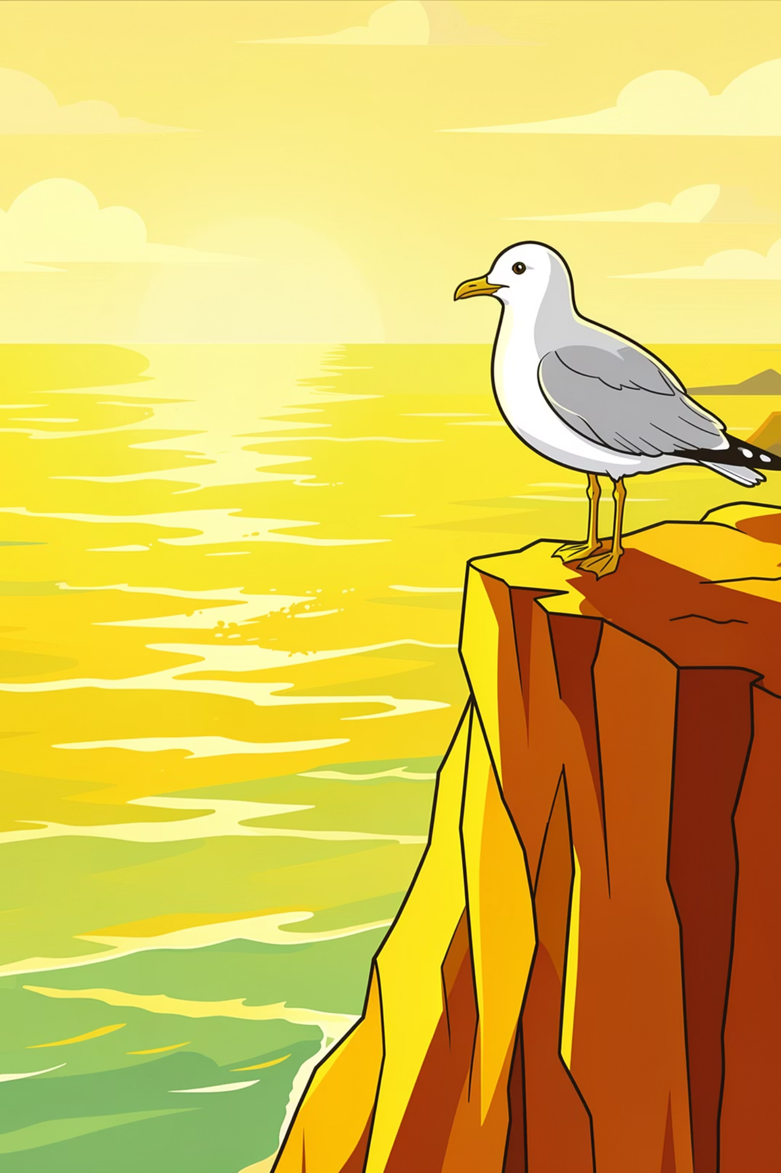
GRADE 10 NCERT – PROSE 3
His First Flight" by Liam O'Flaherty
His First Flight: Conquering the Fear of the Unknown
A timeless tale from Liam O'Flaherty, paralysis to triumph teaches us that courage is not the absence of fear, but the will to act despite it.

Slide 2

The Ledge: A World of Fear
The young seagull stood frozen at the edge of a towering cliff, staring into the vast, terrifying expanse of the sea below. While his brothers and sisters had already taken flight, he alone remained — unable to take that first, decisive step into the open air.
The Setting
A high, narrow ledge on a steep cliff overlooking the Atlantic Ocean
His wings, though fully grown, felt heavy and useless — tools of freedom that had become a source of dread.
The Problem
Paralyzed by the sheer drop — convinced his wings would never hold him up
The Irony
He was a seagull — born to fly — yet fear made the sky feel impossible

Slide 3
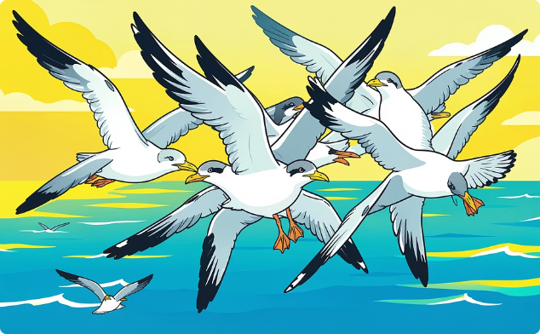
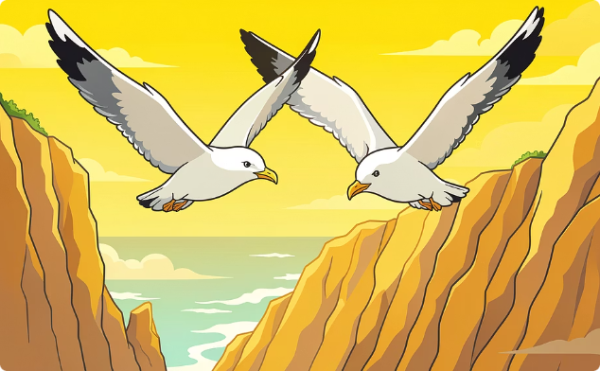
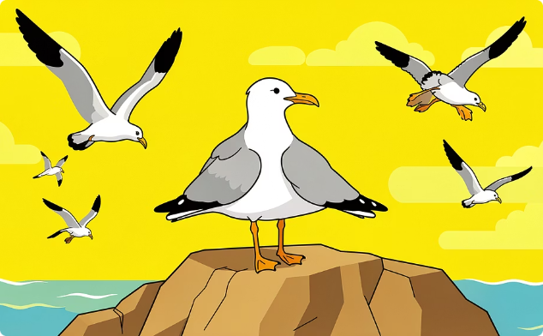
Family's Plea: A Chorus of Encouragement
His family circled the sky around him — his mother, father, and siblings — each one calling out, urging, and beckoning him to spread his wings and join them.
The Parents' Appeal
The Siblings' Taunt
His Stubborn Fear
They called and screamed from the far side of the chasm, demonstrating effortless flight to inspire him.
His brothers and sisters had already flown — their ease in the air only deepened his shame and self-doubt.
Despite all pleas and demonstrations, he could not muster the courage to step off the ledge.

Slide 4
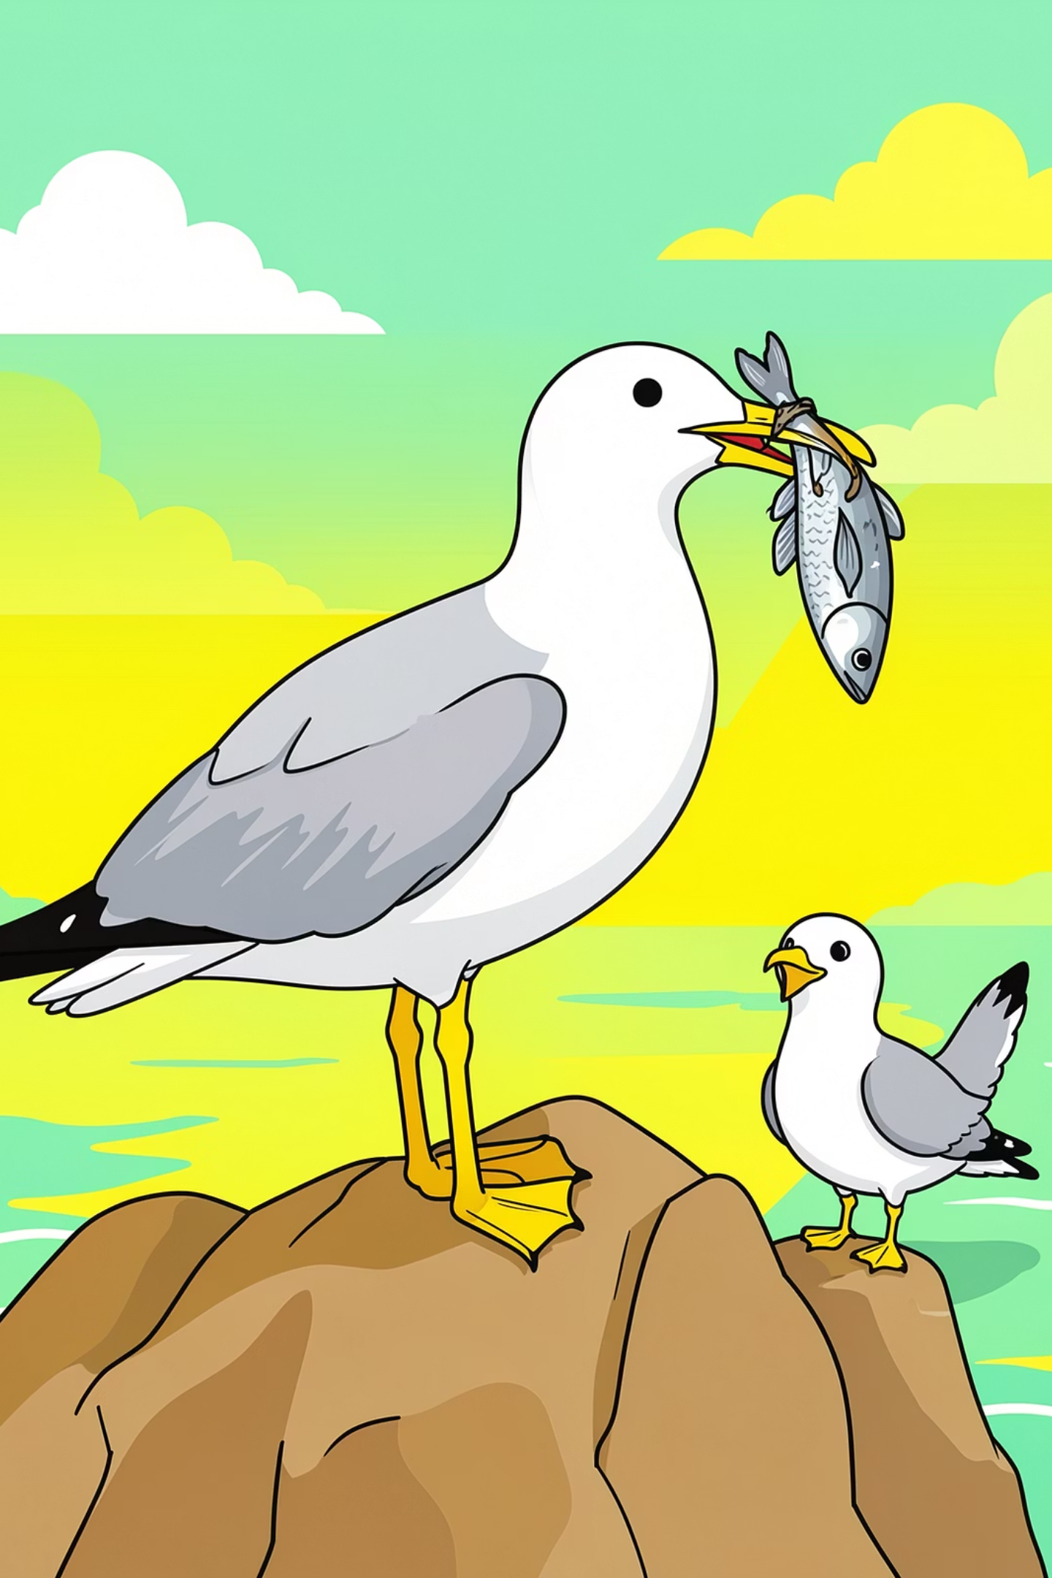
The Hunger Pangs: Nature's Cruel Motivation
For over twenty-four long hours, the young seagull was left entirely alone on the ledge. No food. No comfort. No company. His family deliberately withheld nourishment, hoping desperation would do what encouragement could not.
The Strategy
His mother used hunger as a tool — a deliberate act of tough love designed to push him past his mental barrier when gentle encouragement had completely failed.
Then his mother appeared — tantalizingly close — holding a piece of fish in her beak. She pecked at it, tore it slowly, and looked at him. The scent and sight of food became unbearable.

Slide 5

The Leap of Faith: Driven by Instinct
Maddened Hunger
Dives for Fish
Falls into Air
In a single, impulsive moment — maddened by starvation — he lunged forward at the morsel in his mother's beak. There was no plan, no decision, no courage. Just raw, desperate instinct. And with that one reckless lunge, he tumbled off the ledge and plunged downward into the abyss he had feared for so long.

Slide 6
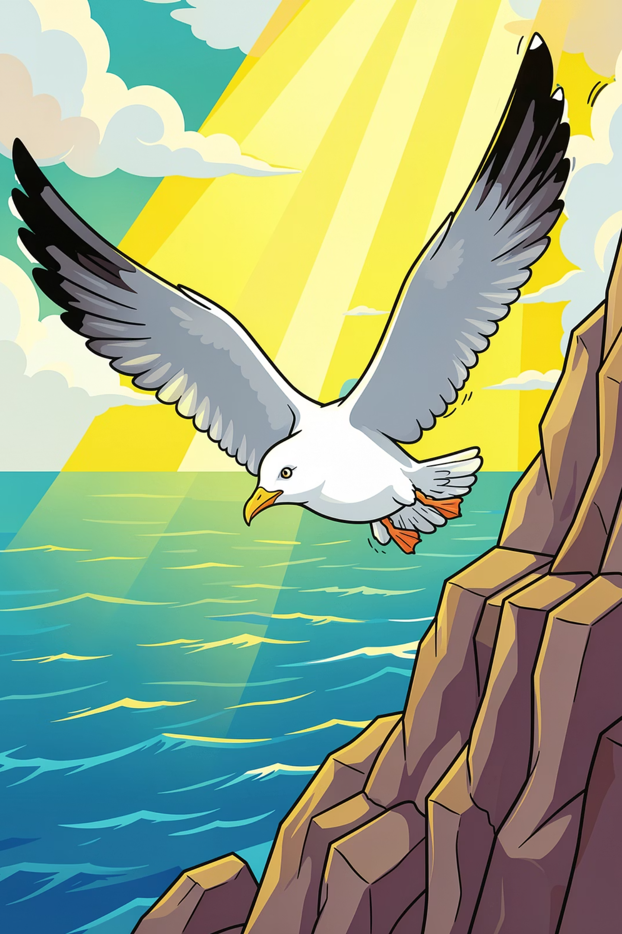
The Fall That Became a Flight
In surrendering to the fall, he discovered the very thing he feared most — the sky — was always meant to carry him.

Slide 7
The Revelation: Wings That Were Meant to Fly
As he plummeted downward, terror gave way to astonishment. Almost involuntarily, his wings stretched wide on either side. The air rushed beneath them, and something miraculous happened — he was no longer falling. He was flying.
Wings Spread
Air Lifted Him
He could feel the wind rushing beneath his wings, lifting him upward. The very thing he dreaded had become his salvation.
Instinct took over — his wings opened automatically
The updraft from the sea caught him, halting the fall
The Realization
He understood — he was exactly like his family. He could fly.

Slide 8
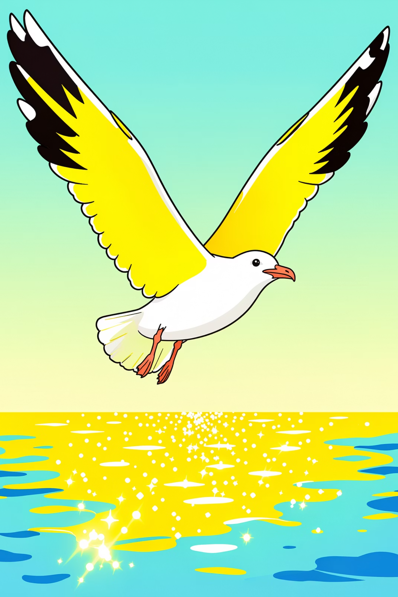
A New World: Soaring Above the Sea
The fear was gone — completely, instantly, forever. In its place surged a wild, triumphant exhilaration. He dipped and soared, banked and glided, a joyous cry ringing out across the water as his family swooped around him in celebration. The sea that had once terrified him now sparkled beneath his wings like a vast playground, welcoming him home.

Slide 9
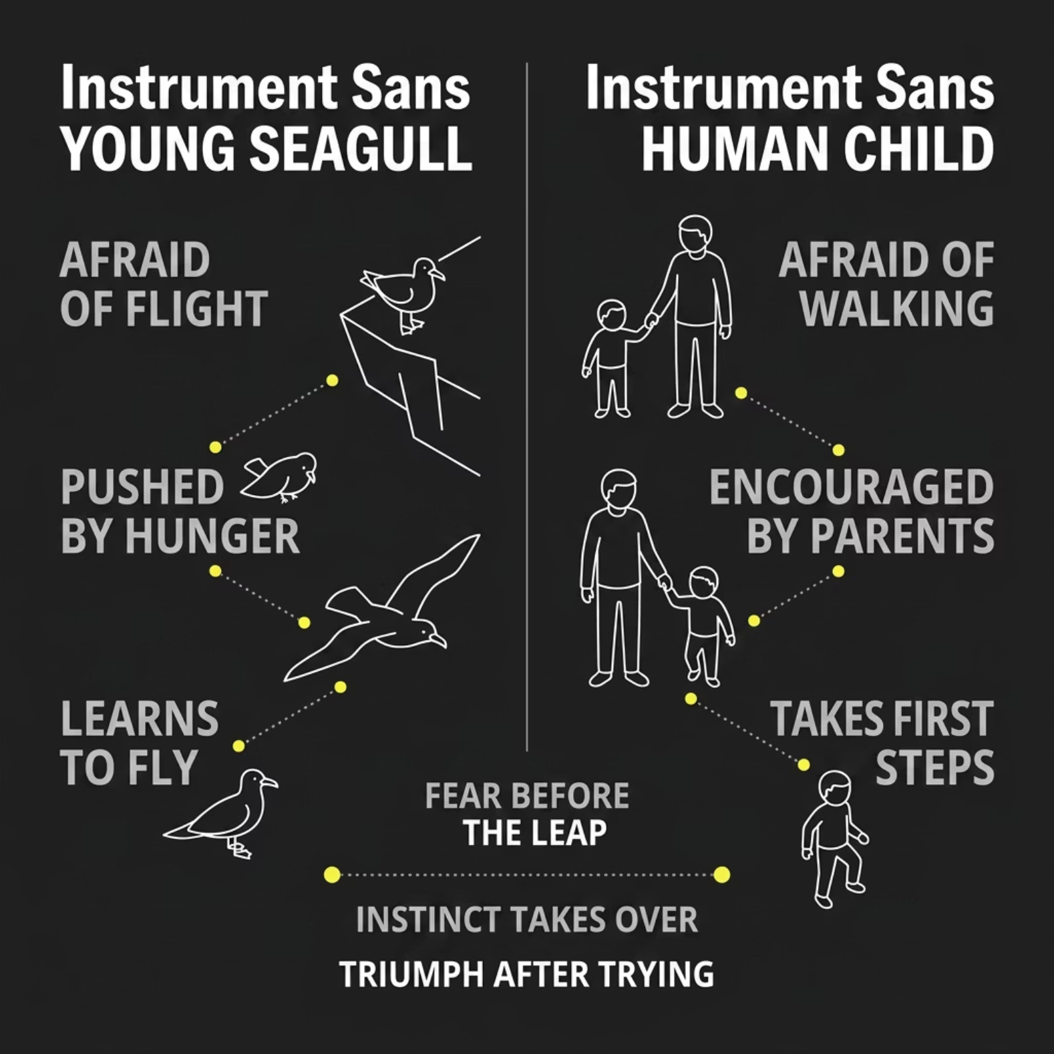


Universal Echoes: The First Steps of All Young
The seagull's story is not just about a bird. It mirrors one of the most universal experiences in nature — the moment every young creature must confront fear and step into the unknown.
Human babies fall repeatedly before they walk — yet they keep trying
Encouragement from family is the common thread across species
Instinct, when finally unleashed, overrides fear every time
O'Flaherty uses the seagull as a metaphor for the universal coming-of-age experience — the terrifying, beautiful moment of independence.

Slide 10
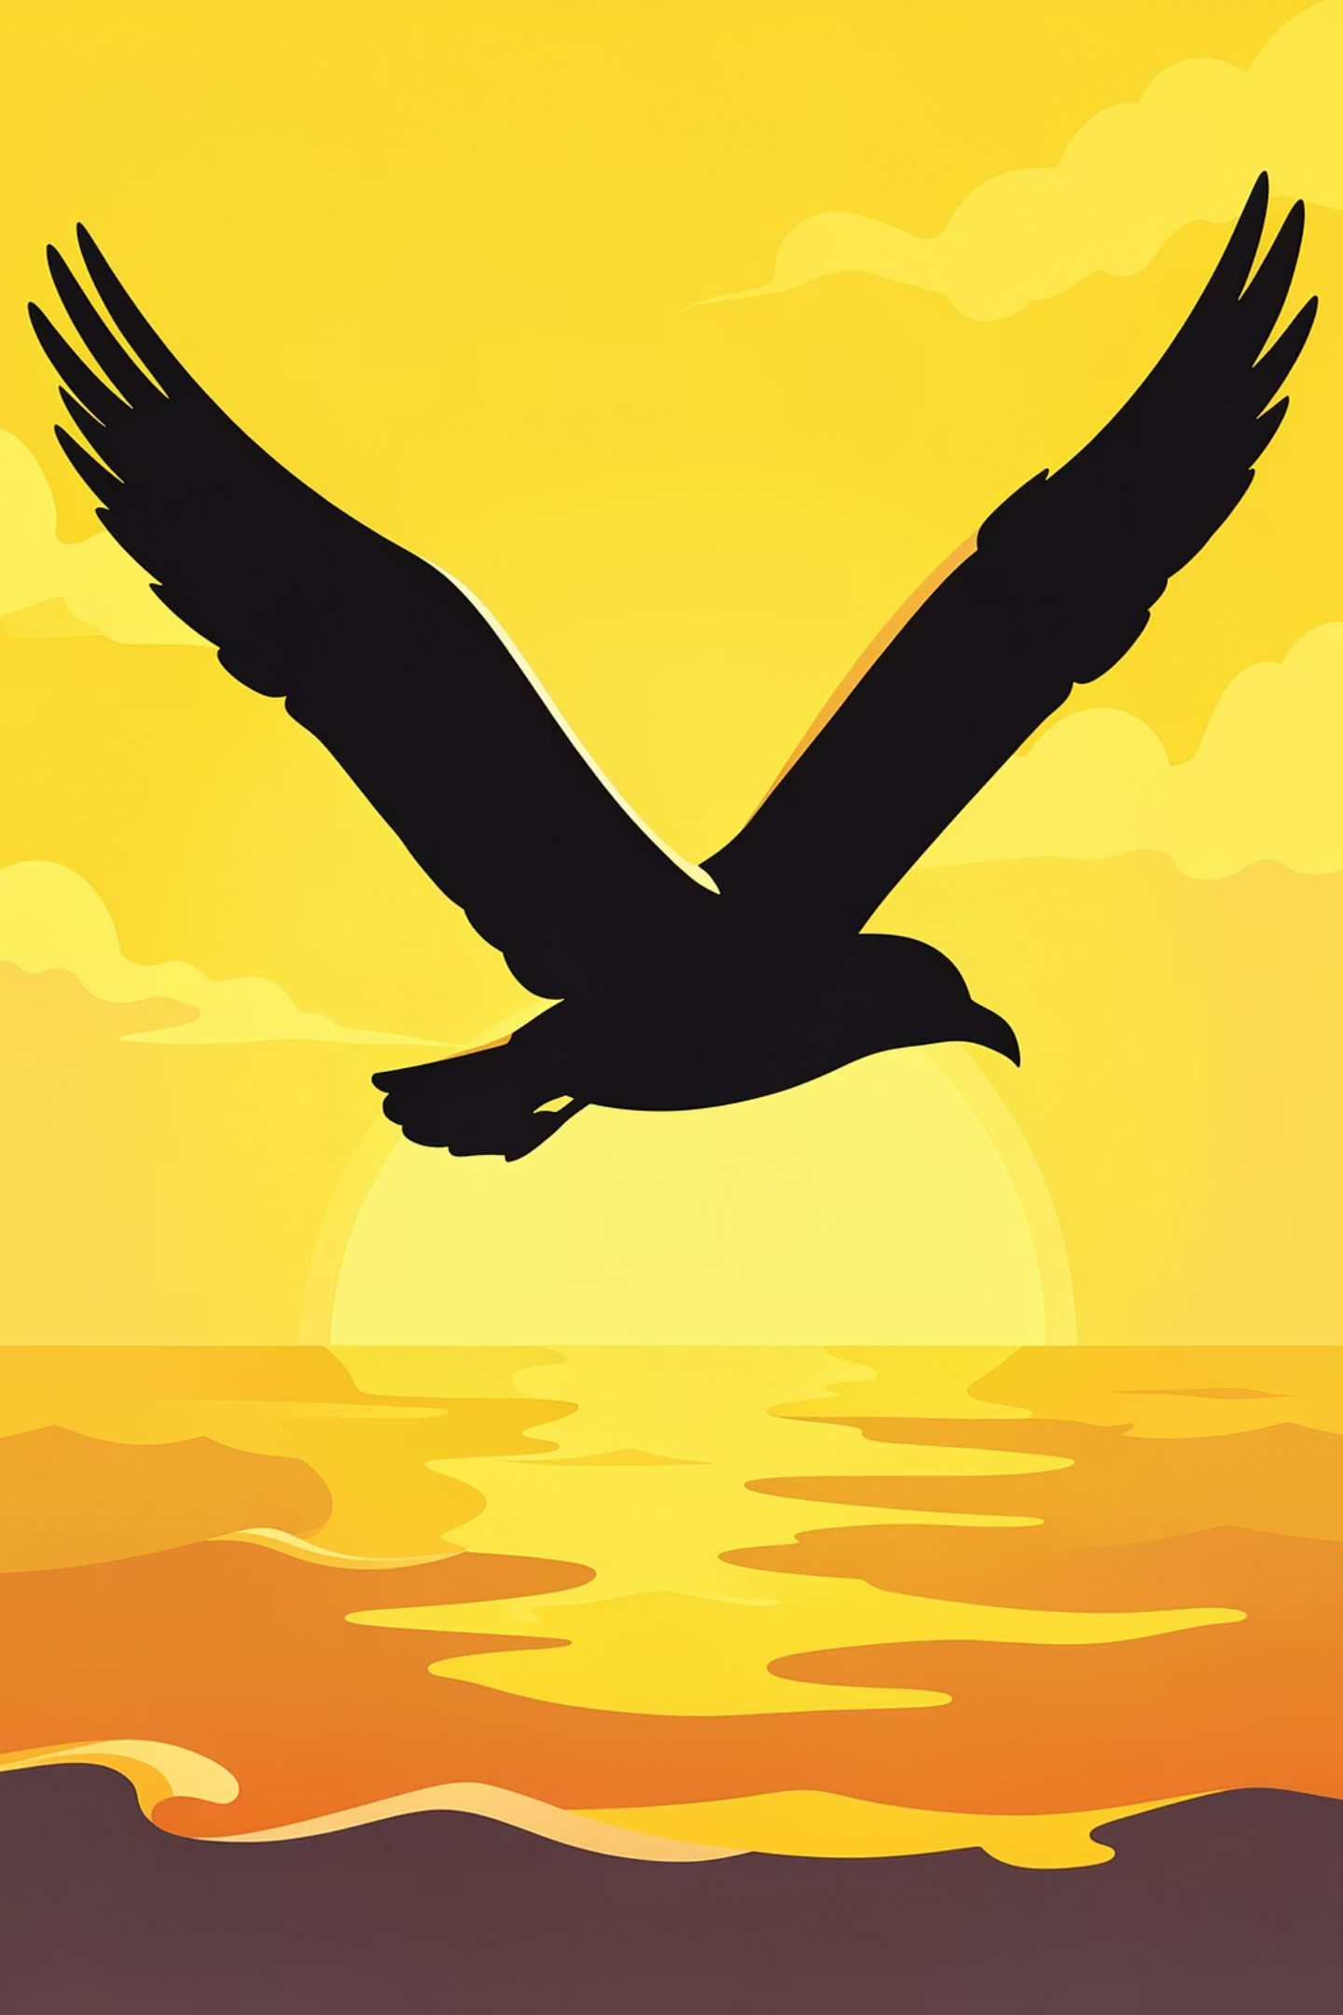
The Triumph of Courage
The young seagull's journey from the ledge to the open sky is a powerful reminder — fear is not a wall, it is a threshold.
The Lesson
The Push
Fear is conquered not by thinking, but by doing — by that one brave, impulsive act of leaping forward.
Sometimes we need hunger — a deadline, a challenge, a crisis — to force us past our hesitation.
The Reward
On the other side of fear lies the sky — vast, exhilarating, and always waiting for those who dare to fly.

